Slide 1
Agile presentation
Justin Haby
SNHU
04/15/2021

Slide 2
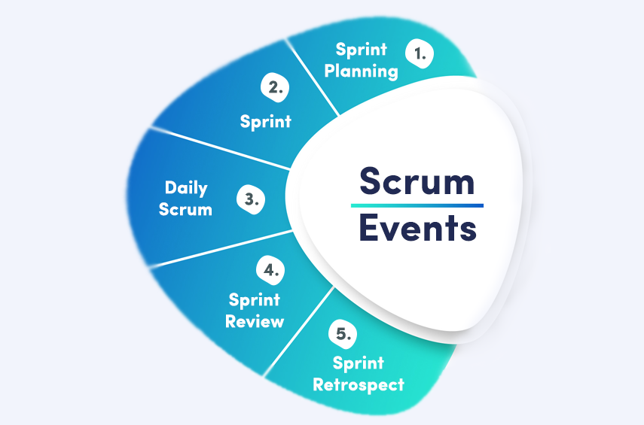
Key Facets of the Scrum-Agile Approach
Scrum agile approach usually comprises of 5 facets:
Sprint planning
Sprint
Daily scrum
Sprint review
Sprint retrospective.
It differs from Waterfall development approach that primarily comprises of:
Requirement analysis’
System design;
Implementation;
Testing;
Execution, and maintenance.
(Agilemania, 2020).
Notes:
The scrum-agile approach defines a modern technique that incorporates, unites, and guides different teams/people into delivering a complex solution (Hoda et al., 2018). Its facets include sprint planning, which entails finalizing what is to be done in the current sprint. Sprint refers to the time-boxed within which teams have to complete a given scrum task. The daily scrum is a usually a 15-minute period used by developers to optimize the development process for it to match the sprint goal. Sprint reviews are meetings where the team members show completed work and answer product increment questions. A sprint retrospective is meetings that reflect on the members' work during a sprint (Hoda et al., 2018).
The agile development approach entails separating the project's lifecycle development into sprints that can be sub-dived into smaller tasks. This differs from the waterfall approach, which is usually divided into distinct phases. The agile approach can allow changes in even after the planning has been completed depending on the requirements, whereas the waterfall approach restricts changes once the project commences (Hoda et al., 2018).

Slide 3
Roles on A scrum Agile-Team
Scrum-agile teams, usually comprise of:
The scrum master
They remove impediments and help team members apply the agile practices to assure success in software development process.
Product owner- entrusted with the duty of identifying ideal features and featuring them in list that’s organized according to preference
They reject and accepting items for product backlog
Development teams-responsible for developing and delivering committed and requested product increment.
The teams include developers and testers of the software.
They decide the number of items to use in building a sprint (Jayaraman, n.d).

Slide 4
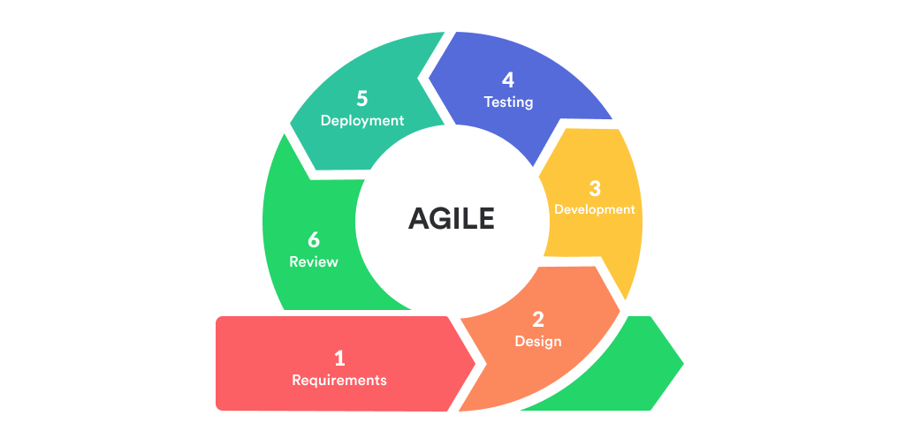
SLDC Phases in Agile
The SDLC phases in agile approach start with:
Gathering requirements;
Design;
Development and coding;
Integration & testing;
Implementation & Coding, and ends with;
Review
(Anurina, 2021).
Notes:
The first phase of SDLC entails stating initial requirements with explanations of the result of the project, supportive features, and non-supportive features. This phase is vital since it helps the developers avoid feature creep. Design phase follows and it involves the development team assembling to discuss how to tackle the requirements. The designers build a mock-up of UI design and further refining of design till it suits the features to ensure that a practical design is reached, and thus effective software development. Development and coding phase, which primarily entails converting design documentation into software and writing code follows. This is the most crucial phase and serves as the backbone of the development process (Leau et al., 2012). The next phases, integration and testing involves ensuring bug-free and compatibility of the software. This phase is vital since it ensures that the software’s business goals are met, and the code is clean through series of tests conducted by the quality assurance team.
The implementation and deployment phase involves providing the software to the customers in demo form or actual use. Finally, the review phase entails the checking the progress taken towards the requirement's completion. This phase is essential since it enables the team asses the problems they encountered in the development process and how to avoid them in the next task (Leau et al., 2012).

Slide 5
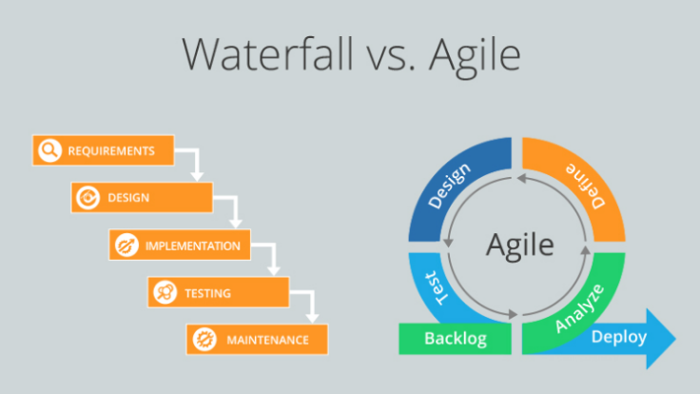
Waterfall Approach
Problems in the waterfall methodology are handled before the next phase
Here, the development process of a software follows a linear sequential flow.
Therefore, each phase’s problems are dealt at that stage.
If a user requirement changes during the process, it will not be captured until the maintenance phase (Tutorial points, n.d).
(Ouriken, 2019).
Notes:
Unlike the agile approach phases that can handle problems and changes even after a phase has passed, the waterfall approach necessitates the team members to address a problem before the next stage is introduced. This is because it is difficult and challenging to go back and handle a problem or make changes. For example, if there were a problem with the software after deployment through customers' feedback, in a waterfall approach, changes would not be possible, and it will necessitate realizing patches or releasing a better version which is done in the maintenance stage, unlike in agile where the problem can be changed even after the deployment of the software (Tutorial points n.d).

Slide 6
Factors to consider when deciding between Agile and waterfall
The agile approach and waterfall approach differ depict different disparities when guiding a project.
When deciding the approach to be used, the following will be considered:
Customer involvement
Flexibility of each approach
Feature prioritization
Team
Funding (Kukhnavets, 2019).
Notes:
Involving customers and product users is vital in eliminating marker risks. If I want to develop the product as fast as possible, I would use the waterfall approach as it will give me a chance to ignore users. However, if I wants to develop a product that meets the demands of many users, I will use the agile approach as it will enable me capture the individual needs and preferences. Consequently, the flexibility of each approach will play a significant role in my decision-making process. If I want changes to be made freely, I will choose agile, whereas if I don’t see the need of such changes when the project has commenced, the waterfall approach will be the better option. Feature prioritization is another factor. Prioritization by value facilitates the implementation of the most valuable features, which lowers the risk of possessing an unusable product if the project's funding runs out. Hence an approach that contains this feature will be more efficient for me. The approach that allows teams to work together is a key consideration for me. Smaller groups are easy to handle and coordinate, which guarantees a high degree of outcomes (Kukhnavets, 2019). Therefore, I will prefer the approach that allows small and manageable teams. Finally, funding is essential in deciding a practical approach. An approach that works exceptionally well with non-fixed funding will be more effective than those that work with fixed funding.

Slide 7
References
Agilemania.(2020). What Is Scrum And How It Works? The Post City. https://www.thepostcity.com/what-is-scrum-and-how-it-works/
Anurina, O. (2021). Agile SDLC: Skyrocketing Your Project with Agile Principles. MLSDev. https://mlsdev.com/blog/agile-sdlc
Hoda, R., Noble, J., & Marshall, S. (2012). Self-organizing roles on agile software development teams. IEEE Transactions on Software Engineering, 39(3), 422-444.
Jayaraman V. (n.d). Leanpitch-the role agile team. Accessed on April 17, 2021. Retrieved from, https://leanpitch.com/blogs/role-of-tester-in-scrum-team#:~:text=The%20development%20team%20in%20Scrum,the%20team%20%26%20critiques%20the%20product.
Kukhnavets P. (2019). Hygger-Agile vs waterfall: the difference between methodologies. Accessed on April 17, 2021. Retrieved from, https://hygger.io/blog/the-difference-between-agile-and-waterfall/.
Leau, Y. B., Loo, W. K., Tham, W. Y., & Tan, S. F. (2012). Software development life cycle AGILE vs traditional approaches. In International Conference on Information and Network Technology (Vol. 37, No. 1, pp. 162-167).
Ouriken. (2019). Which one is right for you: Waterfall or Agile? ouriken. https://ouriken.com/blog/which-one-is-right-for-you-waterfall-or-agile/
Sims, C., & Johnson, H. L. (2011). The elements of scrum (pp. 81-96). Foster City, CA: Dymaxicon.
Tutorialpoints (n.d). SDLC-waterfall model. Accessed on April 17, 2021. Retrieved from, https://www.tutorialspoint.com/sdlc/sdlc_waterfall_model.htm.

